Slide 1
NgRx Workshop
Interaction
Desired ☺
Unravelling Mysteries…
Christian Lüthold & Loris Keller
Zühlke Engineering AG
05.02.2025

Slide 2
Agenda
Part 1 - Theory
What Is State Management?
Storing State in Components vs. Store
Why Not Use Services or Component State?
Core NgRx Features
Memoization
Tips for ICX
Smart & Dumb Components
Best Practice
Part 2 - Practice
Workshop: Building an Angular SPA

Slide 3
What Is State Management?
Definition
Handling synchronizing application state across components.
Why It Matters
Ensures consistency across the application.
Reduces unnecessary API calls.
Improves maintainability and scalability.
Common Approaches
Local Component State
Service-Based State Management
Centralized State Management (e.g., Redux, NgRx)

Slide 4
Storing State in Components vs. Store
Component State
Stores data within the component itself.
Good for UI-specific state (e.g., form input values, toggles).
Becomes hard to manage as the application grows.
NgRx Store
Centralized state management.
Enables predictable state changes.
Enhances debugging with time-travel debugging.
Makes state accessible across multiple components.
When to Use Each
Use component state for ephemeral data that doesn't affect other parts of the app.
Use NgRx for shared and application-wide state that needs to be predictable and consistent.

Slide 5
Why Not Use Services or Component State?
Traditional Approach
Storing state in services using BehaviorSubjects or component state was common before NgRx.
This approach works for small applications but leads to scalability issues.
Challenges with Services
Tight Coupling: Components become directly dependent on services.
State Synchronization Issues: Managing multiple instances of state manually can lead to inconsistencies.
Debugging Difficulties: No built-in time-travel debugging or clear history of state changes.
Boilerplate Code: Requires additional effort to manually sync state across components.
Why NgRx is Better
Provides a unified, predictable approach to state management.
Decouples state from components, making testing and maintenance easier.
Offers powerful debugging tools like Redux DevTools.
Enables better scalability and modularity.

Slide 6
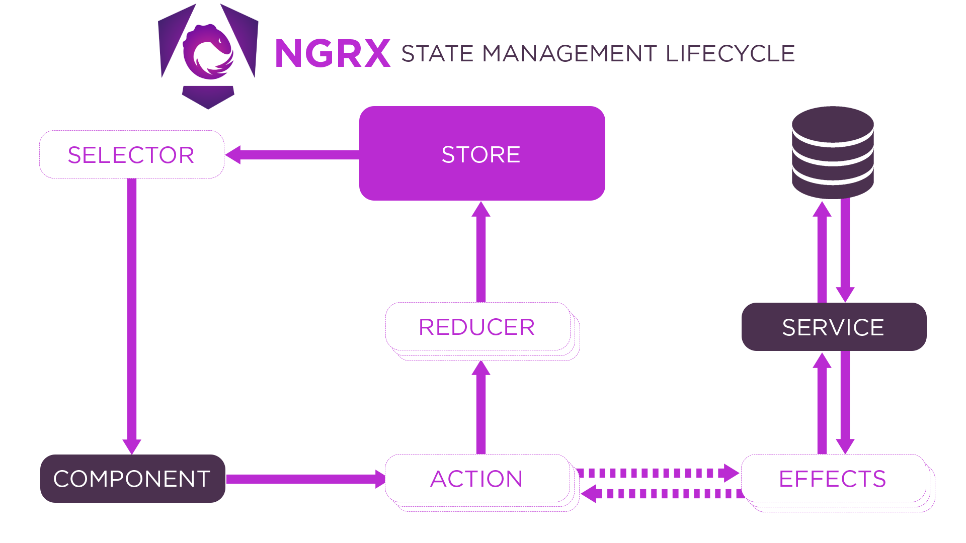
Core NgRx Features
Only one instance! (Also includes all FeatureStores.)

Slide 7


Slide 8
Core NgRx Features
Store The centralized state container that holds the application state and provides access to it.
Actions Define and describe events that cause state changes in the application. Can contain payload.
Reducers Pure functions that determine how state changes based on actions.
Selectors Functions used to efficiently extract specific pieces of state.
Effects Handle (async) side effects such as API calls, logging, or analytics, without cluttering the reducers.
Entity Simplifies managing collections of by normalizing state and reducing boilerplate code.
Router Store Integrates Angular Router state into the NgRx store for better navigation management.
DevTools Provides time-travel debugging and insight into state changes.

Slide 9
Memoization
What is Memoization?
A technique that caches function results to optimize performance.
Ensures that expensive computations (e.g., filtering or aggregating state) are not repeated unless the input changes.
Why Use Memoization in NgRx?
Selectors in NgRx use memoization to avoid unnecessary recalculations.
Improves performance by reducing redundant computations.
Essential for optimizing large-scale applications with frequent state changes.

Slide 10
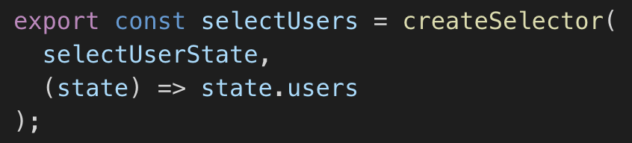
Memoization
How It Works:
If state.users has not changed, NgRx will return the previously computed result.
Prevents unnecessary renders and enhances efficiency.

Slide 11
Tips for ICX
Use Store instead of “Store-Façades” (e.g., MiniAppStore)
Use Selectors instead “Store-Façade”- Getters
Use Store.dispatch() instead of “Store-Façade”- Setters
Create Selectors for combining different Store values (Memoization)
Using the Façades introduces circular dependencies
Reducers
Reducer per State Property
Reducer per Action → Preferred
Actions
Use “SetValueAction(value)” instead of “ToggleValueAction()”
Don’t use “AnythingAction”, “AnythingActionSuccess”, “AnyThingActionFailed” for everything.

Slide 12
Smart & Dumb Components
Definition
Smart Components: Handle state management, dispatch actions, and retrieve state from the store.
Dumb Components: Focus on UI, receive data via inputs, and emit events.
Benefits
Encourages separation of concerns.
Easier to test and reuse components. (No mocking of services or stores, making unit testing simpler.)
Usage with Storybook: Dumb components can be easily tested and showcased in isolation.
Additional Notes
Event Communication Dumb components emit events to notify smart components of user interactions. This allows changes to be handled in the smart component, maintaining a unidirectional data flow.
OnPush Change Detection Dumb components can use ChangeDetectionStrategy.OnPush, making them more efficient by reducing unnecessary re-renders.

Slide 13
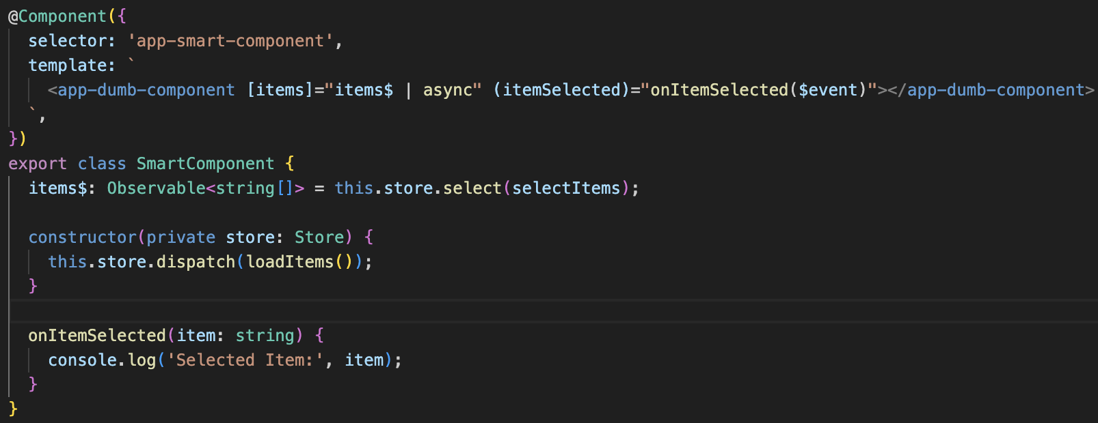
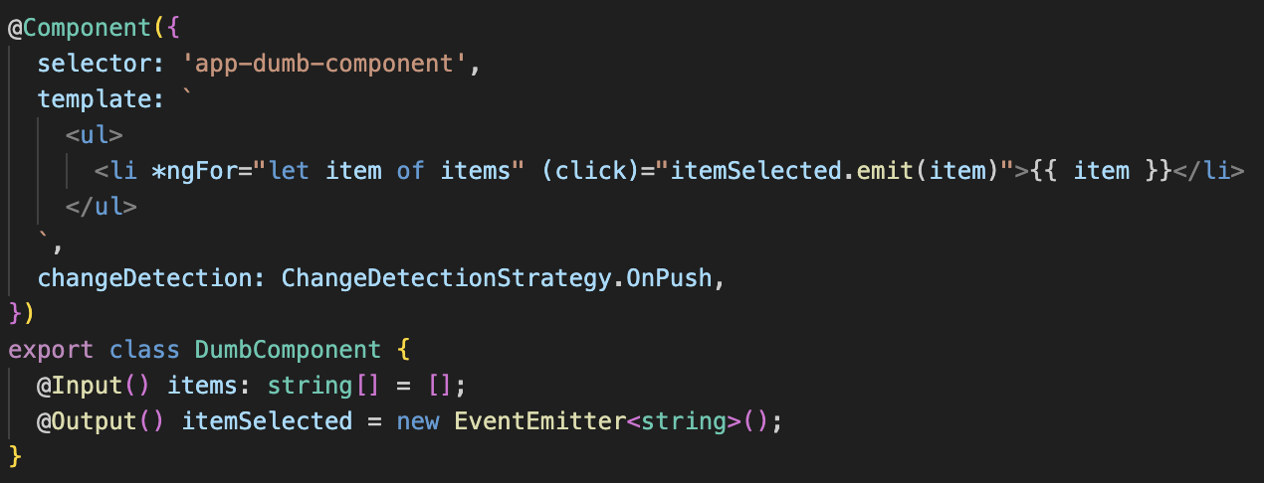

Slide 14
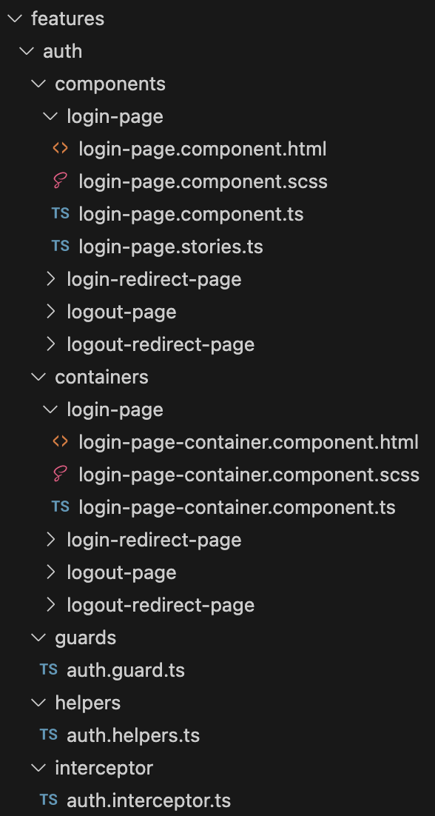
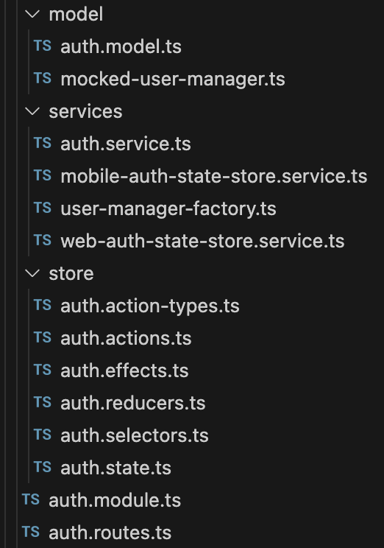
Best Practice
Dumb Components (Inputs & Outputs/EventEmitters, OnPush)
Smart Components (Store, RxJs, Async-Pipe)
Helpers (static, pure functions, encapsule logic that can easily be tested outside of a component context)

Slide 15
Summary
Key Takeaways
State management is crucial for scalable applications.
NgRx provides a structured approach to managing state in Angular.
Smart and dumb components promote modular design.
Tools like NgRx DevTools enhance debugging and performance.
Next Steps
Get comfortable using NgRx in the following part.
Explore advanced NgRx patterns (e.g., feature modules, lazy-loading, optimistic updates).

